Slide 1
OWASP Software Assurance Maturity Model (SAMM)
John Ellingsworth & Hardik Parekh
SAMM Project Team
September 2019

Slide 2
Agenda
OWASP SAMM Introduction
What is OWASP SAMM
Why OWASP SAMM
How to use OWASP SAMM
Project History and background
OWASP SAMM v2.0 and Highlights of Changes over SAMM v1.5
Demo SAMM v2.0 Website and Toolbox
Questions/Feedback

Slide 3
About John Ellingsworth
Education:
Temple University (BA)
Drexel University (MS)
M.I.T. Sloan (Executive Program - currently enrolled)
Career:
Startups (pre-2000): Developer/Tech Lead, Security
Higher Ed (1999-2009): Software Development / Architecture / Security / Management
Corporate (2009-Present): Software Development / Architecture / Security / Management
Membership:
Infragard; OWASP: Maine Chapter, SAMM Project
https://johnellingsworth.com

Slide 4








About Hardik Parekh
Engineering studies
Started as Developer
MS Computer Science, Exposed to security by cryptography
Security Software Developer
Tech lead
Built Pen Testing, Security Testing teams
Tech Lead & Manager Secure SDLC program
Built & Managed
$60 B+ enterprise security program. several contributions to industry - SAFECode publications,
SANS Top 25 programming errors, Supply-Chain Security, CVSS v3.0,
BSIMM v 1.0
Head of Security & Privacy - Intuit Canada
Championed DevSecOps & consumer Privacy
Started contribution to
OWASP SAMM
Head of Security Engg. $13B+ program
Launched Amazon Go,
Post Breach Strategy for WholeFoods Built SOC of 2020
Sr Director, Head of Product & Application Security
Advisory board member
1993
1999
2002
2005
2007
2014
2017
2018
2019

Slide 5
Legal Disclaimer:
We are not speaking on behalf of our current or previous employers, nor we are here as a representative of our current or previous employers.
Our opinions are solely our own, and do not reflect those of our current or previous employers.

Slide 6
What is SAMM?
“The Software Assurance Maturity Model (SAMM) is an open framework to help organizations formulate and implement a strategy for software security that is tailored to the specific risks facing the organization.”
Notes:
What is SAMM?
SAMM about trying to help you structure what you have/are doing and build a plan for how to improve software security
SAMM was defined with flexibility in mind such that it can be utilized by small, medium, and large organizations using any style of development. Additionally, this model can be applied organization-wide, for a single line-of-business, or even for an individual project.
SAMM is full of useful resources that will help with evaluating an organization's current practices, recommendations or suggestions for growing and maturing those practices, providing a way to demonstrate concrete improvements, and defining and measuring security activities throughout the lifecycle.
One of the big benefits of SAMM is that it is vendor agnostic.
SAMM can be done in-house or you can have one of several appsec consulting firms help you with the assessment, goals, plans, roadmaps, etc.

Slide 7
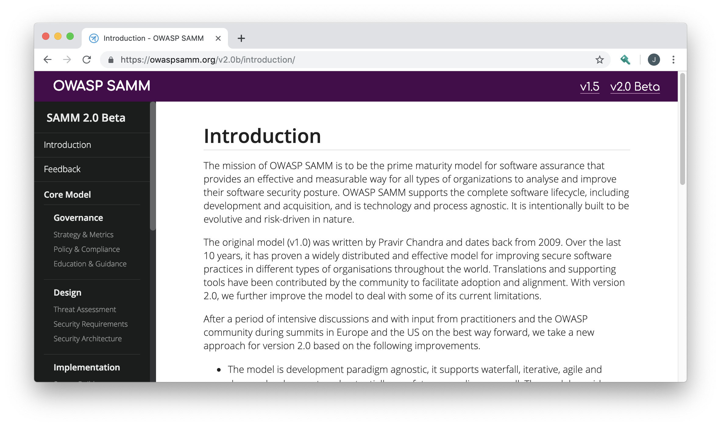
Core Principles of SAMM
An organization’s behavior changes slowly over time
Changes must be iterative while working toward long-term goals
There is no single recipe that works for all organizations
A solution must enable risk-based choices tailored to the organization
Guidance related to security activities must be prescriptive
A solution must provide enough details for non-security-people
Overall, must be simple, well-defined, and measurable
OWASP Software Assurance Maturity Model (SAMM)
Notes:
SAMM is built on a few core principles.
First, an organization's behaviour changes slowly over time. Changes need to be smaller and iterative to really take hold and make a difference.
Second, there is no single recipe that works for all organizations. SAMM is built with this in mind, and supports an organization building a program that is tailored to their risk profile, culture, IT maturity, etc.
Thirdly, Guidance related to security activities must be prescriptive. Too often, security initiatives fail due to poor details, lack of communication, or invalid assumptions.
Overall, the success of the program will be based on being simple, well-defined, and measurable.

Slide 8
What is SAMM?
SAMM will aid in:
Evaluating an organization’s existing software security practices.
Building a balanced software security assurance program in well-defined iterations.
Demonstrating concrete improvements to a security assurance program.
Defining and measuring security-related activities throughout an organization.
Notes:
What is SAMM?
SAMM about trying to help you structure what you have/are doing and build a plan for how to improve software security
SAMM was defined with flexibility in mind such that it can be utilized by small, medium, and large organizations using any style of development. Additionally, this model can be applied organization-wide, for a single line-of-business, or even for an individual project.
SAMM is full of useful resources that will help with evaluating an organization's current practices, recommendations or suggestions for growing and maturing those practices, providing a way to demonstrate concrete improvements, and defining and measuring security activities throughout the lifecycle.
One of the big benefits of SAMM is that it is vendor agnostic.
SAMM can be done in-house or you can have one of several appsec consulting firms help you with the assessment, goals, plans, roadmaps, etc.

Slide 9
What is SAMM?
Business Functions
Security Practices
Maturity Level I
Activities
Maturity Level II
Activities
Maturity Level III
Activities
Notes:
At the highest level, SAMM defines critical business functions. Each business function is a category of security activities related to the nuts-and-bolts of software development.
For each business function, SAMM defines security practices. Each security practice is an area of security-related activities that build assurance for the related business function.
For each security practice, SAMM defines three maturity levels as objectives.

Slide 10
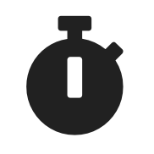


Why SAMM?
Measurable
Defined maturity levels across business practices
Actionable
Clear pathways for improving maturity levels
Versatile
Technology, process, and organization agnostic
Notes:
I like this quote from George Box, who has been called one of the great statistical minds of the 20th century.
<quote>
The point is that you can’t find a model that will exactly describe reality, there too many variables. Models are built in the academic world, we live in the real world.
But, you can have a model that is close enough to be useful, and that is what SAMM is.

Slide 11
How to use SAMM?
How might you implement SAMM?
Culture of company will influence how you adopt it
Organizational Structure
SDLC(s)
Goals
Regulatory Controls
Assessment process is important:
Full interview with stakeholders
Pre-read with response review follow-up
Face to face engagements are critical to success!
Email alone will not work!
Pilot & socialize your efforts
Notes:
I like this quote from George Box, who has been called one of the great statistical minds of the 20th century.
<quote>
The point is that you can’t find a model that will exactly describe reality, there too many variables. Models are built in the academic world, we live in the real world.
But, you can have a model that is close enough to be useful, and that is what SAMM is.

Slide 12
Project History
OpenSAMM 1.0
Release: March 25 2009
OWASP SAMM 1.1
Release: March 2016
OWASP SAMM 2.0 Beta
Release: January 2019
2015
2017
2020
2009
2016
2019
OpenSAMM 1.1
Release: December 2015
OWASP SAMM 1.5
Release: February 2017
OWASP SAMM 2.0
Release: Early 2020
Notes:
Version 1.0 of OpenSAMM was originally created through the OpenSAMM Project led by Pravir Chandra (chandra@owasp.org), an independent software security consultant. Creation of the first draft was made possible through funding from Fortify Software, Inc.
After a number of years, a small group got together at OWASP and worked together to breathe some life into SAMM as an OWASP project.
Version 1.1 of SAMM expanded and restructured its predecessor into four complementary resources:
Core Document: that describes the core SAMM model
How-To Guide: that explains how to apply the model
Quick Start Guide: to help accelerate learning and adoption
Toolbox (spreadsheet): that provides simple automation for data collection, metrics, and graphs.
The project team released v1.5 of SAMM in February 2017, which incorporated a refinement of the scoring model, to provide more granularity to the scoring in an assessment. Now an organization will get credit for all the related work done in a practice rather than having the base number held at the highest completed maturity level.
The updated scoring model was designed to help SAMM assessors and organizations avoid the awkward discussion on whether to mark an answer yes or no when it is honestly something in between, and to show incremental improvements.
The project team began working in earnest on Version 2.0 in June 2017, and officially released the Beta draft for comment at the end of January 2019. In this update, we’ve expanded the breadth of business functions and practices covered, and are working through improvements to the the scoring model to include additional factors.

Slide 13
The Core Team
Hardik Parekh - United States
John Ellingsworth - United States
Sebastien (Seba) Deleersnyder – Project Co-Leader, Belgium
Bart De Win – Project Co-Leader, Belgium
Chris Cooper – Webmaster, United Kingdom
John DiLeo – New Zealand
Daniel Kefer – Germany
Nessim Kisserli – Belgium
Yan Kravchenko – United States
Notes:
Work on Version 2.0 has been performed mostly by a core team of nine volunteers across the globe. Since starting on the new version, the team has met in person four times, and have coordinated our work through fortnightly team calls.

Slide 14
Key changes in SAMM v2.0
SAMM v1.5
SAMM v2.0
Four Business Functions - Governance, Construction, Verification, Operations
12 Security Practices
Very little, if any, prescriptive guidance for build and deploy domains
Maturity level activities could be orphaned, and sometimes unrelated to each other
Maturity level activities not in order of increasing difficulty, cost of implementation
Coverage based measurement
Five Business Functions - Governance, Design, Implementation, Verification, Operations
15 Security Practices
New Business Function "Implementation" to accommodate guidance related to build and deploy domains
Maturity level activities are aligned and linked per Stream. Each streatm has a clear Objective
Maturity level activities designed in order of increasing difficulty, implementation cost
Coverage & Quality based measurement
Notes:
SAMM v2.0 introduced key changes.
SAMM v2.0 Core model incorporates five Business Functions and 15 Security Practices. SAMM v1.5 “Construction” Business Function has been converted to “Design” Business Function to make it more intuitive to today’s software development professionals; and new fifth Business Function “Implementation” has been introduced to represent a number of core security activities in the build and deploy domains of an organisation. Introduction of “Implementation” Business Function provides prescriptive security guidance related to build and deploy activities of today’s DevOps model.
Another improvement in SAMM v2.0 is that each security practice is divided in two “streams”, which aligns and links the security activities in the practice across different maturity levels. Each stream has an objective to be reached, and this objective can be reached in increasing levels of maturity. This way, we ensure that there are no “orphan” activities that seem only relevant on a single maturity level (like, for instance, code signing in the SAMM v1.5 Operational Enablement Security Practice).
SAMM v2.0 maturity levels have been designed with increasing levels of difficulty and implementation cost in mind. This is to address one of the shortcomings of SAMM v1.5 where several security practice maturity levels were not designed with this in mind; so it was possible to achieve higher level of maturity relatively easily compared to lower level of maturity.
In SAMM v2.0, we are working through improvements to the the scoring model to include additional factors such as Quality. More on this later.

Slide 15
SAMM v2.0 Core Framework
Governance
Strategy & Metrics | Create and Promote | Measure and Improve
Policy & Compliance | Policy and Standards | Compliance Management
Education & Guidance | Training and Awareness | Organization and Culture
Design
Threat Assessment | Application Risk Profile | Threat Modeling
Security Requirements | Software Requirements | Supplier Security
Secure Architecture | Architecture Design | Technology Management
Implementation
Secure Build | Build Process | Software Dependencies
Secure Deployment | Deployment Process | Secret Management
Defect Management | Defect Tracking (Flaws/Bugs/Process) | Metrics and Feedback/Learning
Verification
Architecture Assessment | Architecture Validation | Architecture Compliance
Requirements Driven Testing | Control Verification | Misuse/Abuse Testing
Security Testing | Scalable Baseline | Deep Understanding
Operations
Incident Management | Incident Detection | Incident Response
Environment Management | Configuration Hardening | Patching and Updating
Operational Management | Data Protection | System decommissioning / Legacy management
Notes:
SAMM v2.0 Core Framework
The foundation of the SAMM v2.0 model is built upon the core business functions of software development - Governance, Design, Implementation, Verification and Operations. There are 3 security practices tied to each Business Function. The building blocks of the model are the three maturity levels defined for each of the fifteen security practices.
These define a wide variety of activities in which an organization could engage to reduce security risks and increase software
assurance. Additional details are included to measure successful activity performance, understand the associated assurance benefits,
estimate personnel and other costs.

Slide 16
Activity Streams & Maturity Levels
Verification - Requirements Driven Testing
Maturity
 | A: Control Verification | B: Misuse/Abuse Testing
Maturity 1 - Opportunistically find basic vulnerabilities and other security issues. | Test for standard security controls | Perform security fuzzing testing
Maturity 2 - Perform implementation review to discover application-specific risks against the security requirements. | Derive test cases from known security requirements | Create and test abuse cases and business logic flaw test
Maturity 3 - Maintain the application security level after bug fixes, changes or during maintenance | Perform regression testing (with security unit tests) | Denial of service and security stress testing
Streams
Activities
This security practice focuses on creating and integrating both positive (Control Verification) and negative (Misuse/Abuse Testing) security tests based on requirements (user stories)..
Notes:
Let’s take a closer look at one of the security practices Requirements Driven Testing under Verification Business Function.
Requirements Driven Testing security practice is divided in two “streams” - A: Control Verification; and B: Misuse/Abuse Testing. These streams align and link the activities in the practice over the different maturity levels. Each stream has an objective to be reached, and this objective can be reached in increasing levels of maturity.
This way, we ensure that there are no “orphan” activities that seem only relevant on a single maturity level (like, for instance, code signing in the current model).

Slide 17
Pain Points with Scoring in SAMM 1.5
Strategy & Metrics, Level 1: Is there a software security assurance program in place?
Available Responses:
No
Yes, it‘s less than a year old
Yes, it‘s a number of years old
Yes, it‘s a pretty mature program
But, what about…
Quality of the program?
Currency of the program? Has it been reviewed/updated?
How do you know the program is still relevant?
Notes:
While designing the scoring model for SAMM v2.0, we considered pain points related for the scoring in SAMM v1.5. These are some of the aspects which are not covered in v1.5.

Slide 18
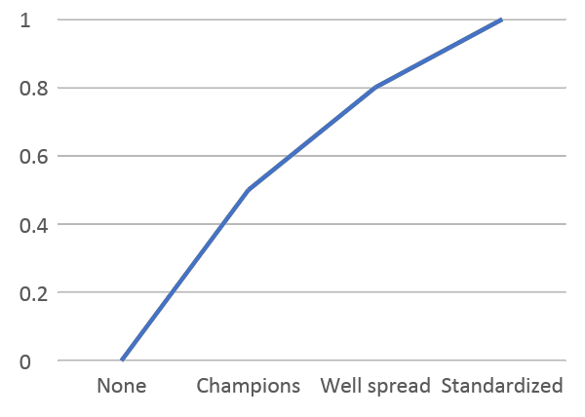
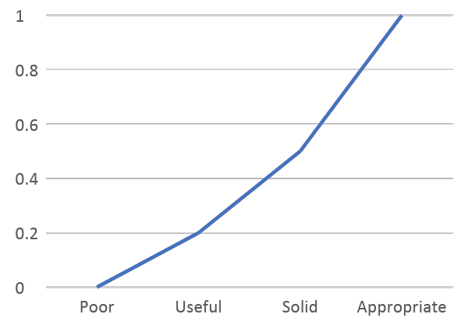
Consider Multiple Dimensions
Coverage / Standardisation
Quality
Notes:
The project team released v1.5 of SAMM in February 2017, which incorporated a refinement of the scoring model, to provide more granularity to the scoring in an assessment. However, v1.5 SAMM still has limitation of not considering Qualitative aspects of the score. It only provide coverage based measurement.
In this update, we are working through improvements to the the scoring model to include additional factors such as Quality.

Slide 19
Considerations while designing SAMM 2.0 Scoring
Response scales/values for quality and coverage questions
Four options? Five?
Linear?
How to compute overall maturity score from individual metric scores across levels
Level 2 significantly more expensive than Level 1
Should we use weightage to represent higher maturity level?
Notes:
These are some of the other considerations while designing the scoring model for SAMM v2.0

Slide 20
Maturity Score = Sum(Avg(StreamALevel1,StreamBLevel1)+Avg(StreamALevel2,StreamBLevel2)+Avg(StreamALevel3,StreamBLevel3))
Stream | Level | Requirements Testing |  | Answer
A: Control Verification | 1 | Do you test applications for the correct functioning of standard security controls? |  | Yes, the majority of them | 1 | 0.750
 | QC: | Security testing at least verifies the implementation of authentication, access control, input validation, encoding and escaping data, and encryption controls.
 | QC: | Security testing executes whenever the application changes its use of the controls.
 | 2 | Do you test security controls based on the specific application security requirements? |  | Yes, some of them | 0.2 | 0.200
 | QC: | Tests are tailored to each application and assert expected security functionality.
 | QC: | Test results are captured as a pass or fail condition
 | 3 | Do you automatically test applications for security regressions? |  | No | 0 | 0.000
 | QC: | Tests are consistently written for all identified bugs (possibly exceeding a pre-defined severity threshhold)
 | QC: | Security tests are collected in a test suite that is part of the existing unit testing framework
B: Misuse/Abuse Testing | 1 | Do you test applications using randomization techniques? |  | Yes, at least half of them | 0.5
 | QC: | Testing covers most or all of the application's main input parameters
 | QC: | All application crashes are recorded and systematically inspected for security impact
 | 2 | Do you create abuse cases from functional requirements and use them to drive security tests? |  | Yes, sometimes | 0.2
 | QC: | Important business functionality has corresponding abuse cases
 | QC: | You build abuse stories around relevant personas with well-defined motivations and characteristics
 | QC: | You capture identified weaknesses as security requirements
 | 3 | Do you perform denial of service and security stress testing? |  | No | 0
 | QC: | Stress tests target specific application resources (e.g. memory exhaustion by saving large amounts of data to a user session)
 | QC: | You design tests around relevant personas with well-defined capabilities (knowledge, resources)
Rating
0.95
Notes:
Finally, we came up with new scoring model which still primarily based on the coverage. However, we added Quality Criteria for each Question to add another dimension to the score. Our guidance is to score “0” if Quality Criteria are not met.
Overall maturity score for the security practice is calculated by taking average of maturing level 1 between stream A and B and adding that to each level of maturity. We will spend more time on this during Toolbox demo.

Slide 21
Implementation - Secure Build
This security practice focuses on creating a consistently repeatable secure build process and accounting for the security of application dependencies.
 | A: Build Process | B: Software Dependencies
Maturity 1 - Build process is repeatable and consistent | The build process is defined and consistent. | All application dependencies are identified and documented
Maturity 2 - Build process is optimized and fully integrated into the workflow | The build process is fully automated and does not require intervention by the developer. | All components and libraries are periodically reviewed for known security vulnerabilities and licensing issues
Maturity 3 - Build process helps prevent known defects from entering the production environment. | Security defects may trigger the build to stop executing | Components and libraries are independently scanned for vulnerabilities
Notes:
This practice focuses on creating a consistently repeatable secure build process and accounting for the security of application dependencies.
Long Description
The Secure Build practice emphasises the importance of building software in a standardised, repeatable manner, and of doing so using secure components, including 3rd party software dependencies.
The first stream focuses on removing any subjectivity from the build process by striving for full automation. An automated build pipeline can include additional automated security checks such as SAST and DAST to gain further assurance and flag security regressions early by failing the build for example.
The second stream acknowledges the prevalence of software dependencies in modern applications. It aims to identify them and track their security status in order to contain the impact of their insecurity on an otherwise secure application. In an advanced form, it applies similar security checks to software dependencies as to the application itself.

Slide 22
Implementation - Secure Deployment
This security practice focuses on automatically securing deployments to the production environment and all required secrets.
 | A: Deployment Process | B: Secret Management
Maturity 1 - Deployment processes are fully documented | Deployment is automated or done by someone other than the developer. | Production secrets are encrypted and not handled by developers
Maturity 2 - Deployment processes include security verification milestores | Integration of security verification in deployment (e.g. binary static code analysis / AV scan) | Secrets are dynamically included during the deployment process
Maturity 3 - Deployment process is fully automated and incorporates automated verification of all critical milestones | Integrity of the code is verified prior to deployment | Files and repositories are checked periodically for secrets that should be protected
Notes:
Short Description
This practice focuses on automatically securing deployments to the production environment and all required secrets.
Long Description
One of the final stages in delivering secure software is ensuring the security and integrity of developed applications are not compromised during their deployment. To this end, the practice’s first stream focuses on removing manual error by automating the deployment process as much as possible, and making its success contingent upon the outcomes of integrated security verification checks. It also fosters Separation of Duties by making adequately trained, non-developers responsible for deployment.
The second stream goes beyond the mechanics of deployment, and focuses on protecting the privacy and integrity of sensitive data, such as passwords, tokens, and other secrets, required for applications to operate in production environments. In its simplest form, suitable production secrets are moved from repositories and configuration files into adequately managed digital vaults. In more advanced forms, secrets are dynamically generated at deployment time and routine processes detect and mitigate the presence of any unprotected secrets in the environment.

Slide 23
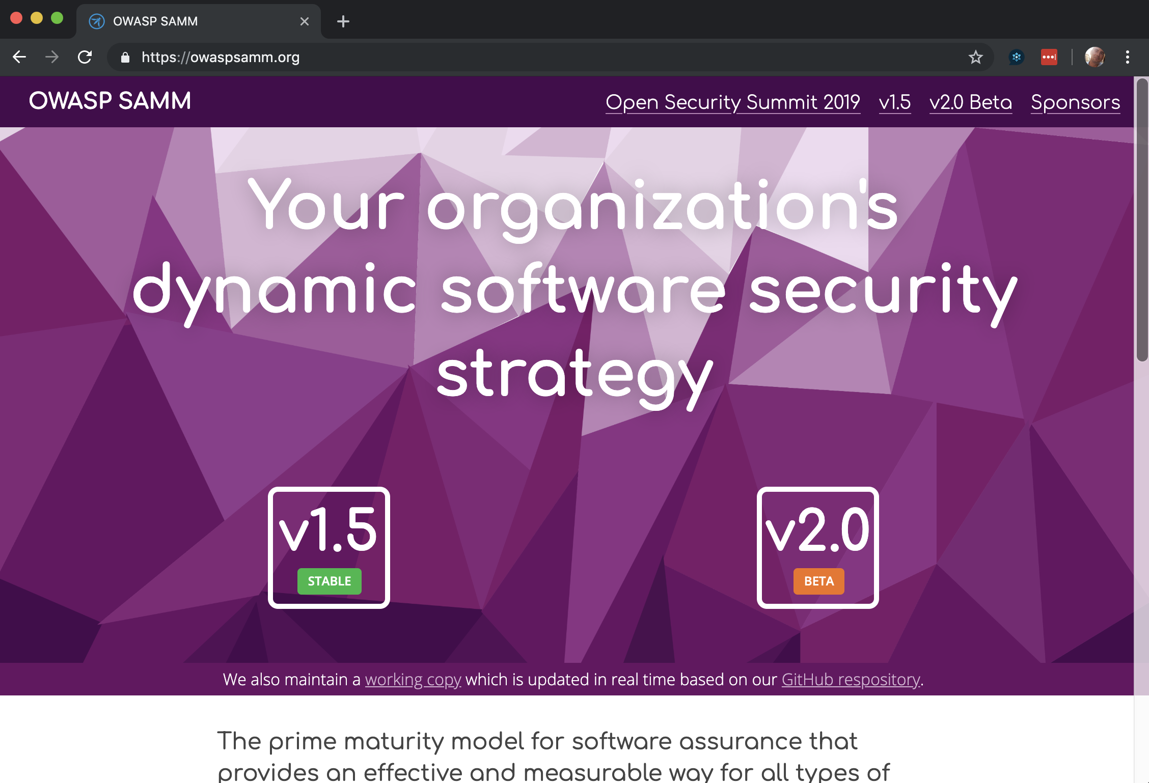
Owaspsamm.org and toolbox demo
Notes:
Let’s walk through demo of owaspsamm.org website and the SAMM toolbox.

Slide 24



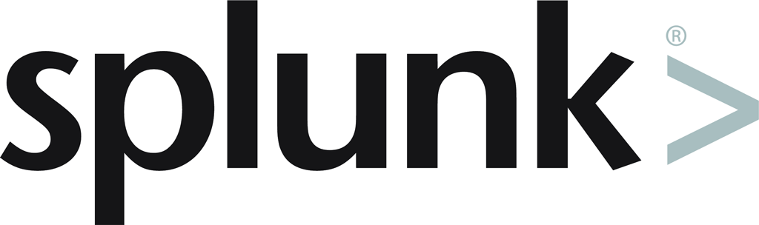
Thank You to Our Sponsors
Sponsorship opportunities still available!
Notes:
Thank you to our Sponsors. There are more Sponsorship opportunities still available! Please contact us if you would like to be a project sponsor.

Slide 25
Thank You to OWASP Community and Volunteers
Notes:
Thank you to OWASP community and volunteers for putting together nice conference!

Slide 26
Questions/Feedback

Slide 27
OWASP Software Assurance Maturity Model (SAMM)
Project Update
Notes:
Rate this session.

